Slide 1
China Market Analysis
Jan 01, 2023, to Dec 15, 2024

Slide 2
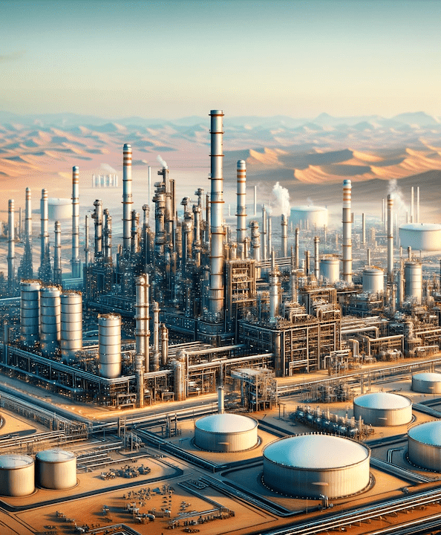
Contents
01
Objective and Methodology
02
Key Takeaways
03
Background – China’s GDP, Industrial Outlook, Energy Demand
04
China’s Economic Overview and Analysis of Aramco’s role
05
Challenges and Points of Misalignment

Slide 3


Objective & Methodology
Study Overview: Background, Goals, and Approach
Background:
China is experiencing an economic slump, raising concerns about its energy demand and market stability. Aramco has made significant investment commitments in China, but questions are emerging about whether these promises are achievable given the current economic climate. Under-delivering and overpromising could have a detrimental effect on Aramco’s reputation in China, a priority market for the expansion of the Company’s downstream business.
Objective:
Burson reached out to C5i to examine the media coverage, legislative activity, and global context (political shifts, geopolitical tensions, etc.) over 2023 and 2024 to:
Provide an overview of China’s economic outlook and its implications for the oil and gas sector.
Analyze Aramco’s recent press releases and media coverage in China.
Identify misalignments between Aramco’s stated ambitions and China’s economic realities.
Assess reputational risks and offer strategic recommendations.
Methodology:
C5i leveraged desk research & social media analytics capabilities to answer the objective
Time Frame:
Approach
Jan 01, 2023, to Dec 15, 2024
Developed framework to gather relevant data around China’s economic outlook and Aramco’s initiatives in China
Developed query with keywords using the Boolean logic and ingested it through Brandwatch
Aggregated data and eliminated the noise/junk
Analyzed the data and reported to arrive at the analysis around the key objective
Source:
Brandwatch for Social Listening and Media and Press Releases for Desk Research

Slide 4
Key Takeaways
China’s economic outlook and Aramco’s strategic contribution in China

Slide 5
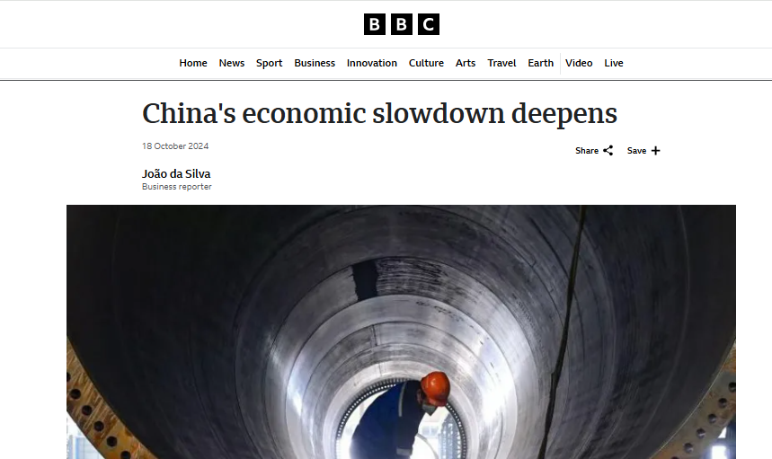


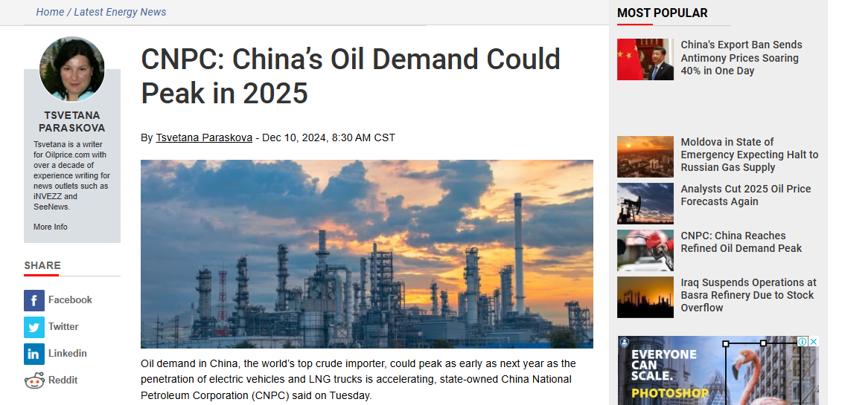

China’s economic growth started decelerating since Q2 2024. The energy demand, however, is expected to peak as early as 2025
Key Takeaways – China’s Economic Outlook
 | Policy Shifts in China: The government has been pivoting toward green energy and carbon neutrality transitioning to cleaner energy with an increased use of LNG-fueled vehicles and EVs, leading to reduced oil consumption
 | Energy Demand in China: Despite growth in renewable energy investments, oil and gas demand remains robust and is expected to peak in 2025, although highly price-sensitive. The demand for Diesel and gasoline is also expected to weaken.
 | China’s GDP: The economic growth in China has however decelerated. Persistent property sector issues and declining foreign investment due to geopolitical tensions are affecting the country’s economic growth.

Slide 6
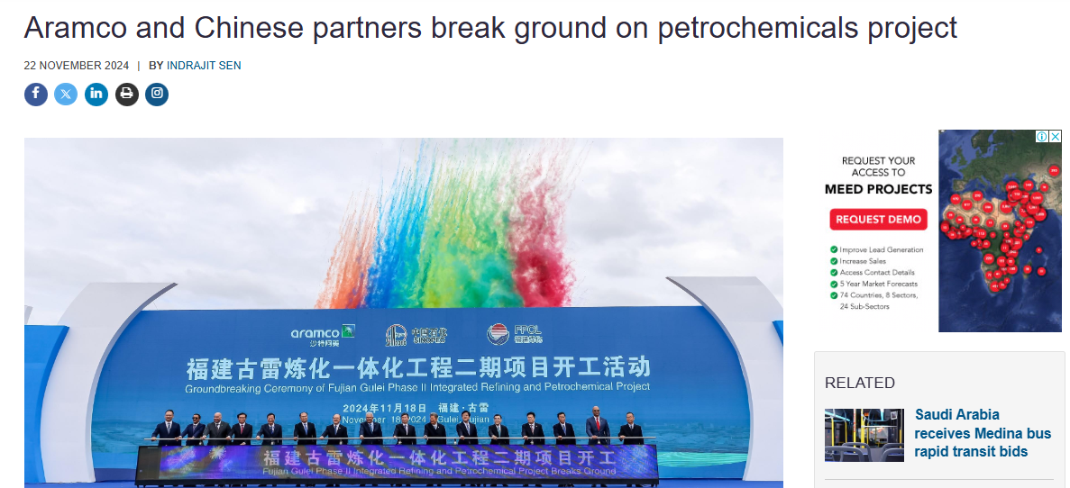

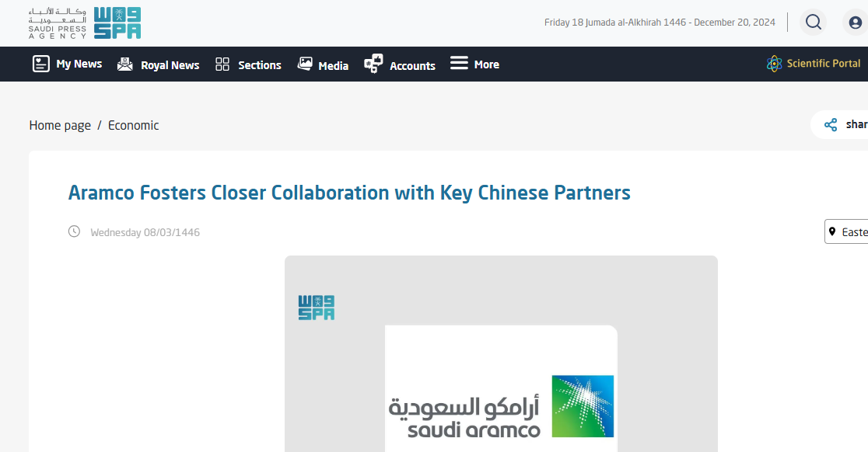

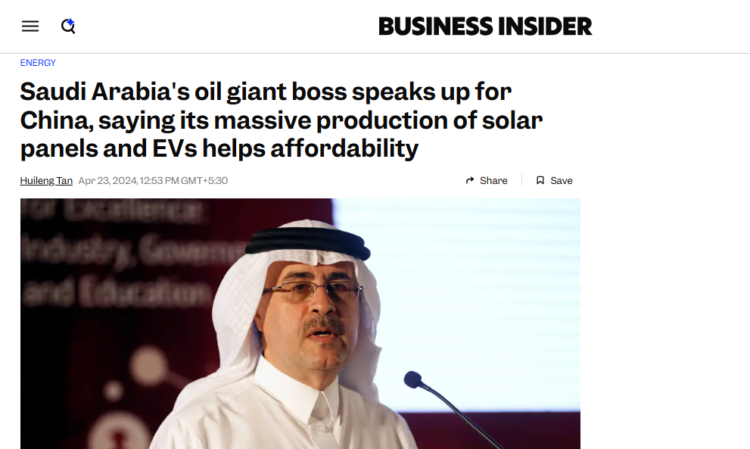
Aramco is strengthening strategic partnerships in China, while navigating policy shifts, energy demand, and a slowing economy
Key Takeaways and Aramco’s Role in China
 | Aramco’s Significant Financial Contributions and Strategic Partnerships: Aramco is forming alliances with key Chinese corporations, particularly in the petrochemical and construction sectors, to enhance mutual growth and sustainability efforts. Aramco is also demonstrating a long-term commitment to China's economic development and fostering closer relationships through development investments, community engagement, and sports sponsorships
 | Implications for Aramco: In alignment with the country’s policy shifts and dynamic economic landscape, Aramco can increasingly support China’s energy needs in the short term while adapting to its green energy goals and navigating economic and geopolitical challenges.

Slide 7
China’s Economic Overview
Background of the GDP trends, Industrial output, Energy demand and other factors

Slide 8
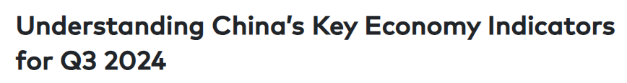
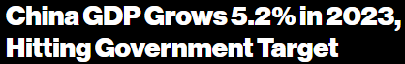


China's economy showed growth and challenges, with GDP declining since Q2 2024 due to shifts in consumption, geopolitical tensions, property sector issues, and falling foreign investment
Background – China’s Economic Overview
China’s economy showed strength in 2023 and a slight downturn in 2024. Consumer demand and the real estate industry had challenges, but the economy was still driven by industrial production, renewable energy, and foreign investments. The energy sector is realigning with a gradual shift to renewables and nuclear energy, while diesel and gasoline demand is expected to decline with changing consumption and demand trends, China’s petroleum consumption is expected to peak
GDP Trends:
2023 Performance:
China’s GDP grew by 5.2%, achieving the government’s target of ‘around 5%’.
Growth was supported by rising industrial production and investment in the latter half of the year.
2024 Overview:
The GDP target 2024 was set at 5%, with cautious optimism amid global uncertainties.
In the first three quarters of 2024, China's GDP grew by 4.8% year-on-year, totaling RMB 94.97 trillion (approximately US$13 trillion).
Timeframe: Jan 01, 2023, to Dec 15, 2024 Source: Desk Research – Media Coverage

Slide 9
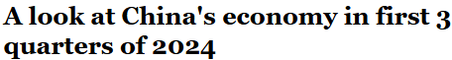
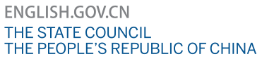
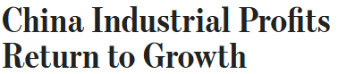

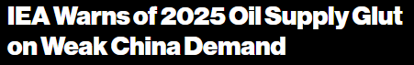
China's industrial sector faced overcapacity, especially in high-tech industries like solar panels, electric vehicles, and steel, leading to global market disruptions, price drops, and trade tensions
Background - China’s Industrial Output
Industrial Output:
High-tech sectors, including electronics and pharmaceuticals, saw significant growth with a 9.1% increase in output in 2023.
Despite output growth, industrial profits faced volatility. In the first two months of 2024, profits at industrial firms increased by 10.2%, compared to a 2.3% decline for all of 2023, reflecting a rebound in the sector.
China's industrial sector struggled with overcapacity, particularly in high-tech industries like solar panels, electric vehicles, and steel. This led to global market disruptions and trade tensions, as Chinese exports surged, causing price reductions and prompting protective measures from other countries.
Timeframe: Jan 01, 2023, to Dec 15, 2024 Source: Desk Research – Media Coverage
Notes:
Move the Aramco part in another slide with the Aramco section

Slide 10
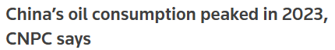

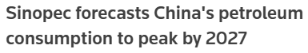
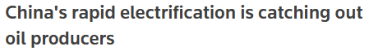
China's energy demand has seen significant changes over the past two years, influenced by economic shifts, policy decisions, and technological advancements
Background - China’s Energy Demand
Energy Demand:
In 2023, China's refined oil consumption peaked at 399 million metric tons (approximately 7.98 million barrels per day) and was projected to decline by 1.3% in 2024. This downturn is largely attributed to the increasing adoption of electric vehicles (EVs) and a slowing economy.
China's shift towards electrification, particularly in transportation, is reducing global oil demand, with the IEA noting that EV adoption could displace around 6 million barrels per day of crude oil demand.
China’s petroleum consumption is expected to peak by 2027, according to Sinopec forecasts.
The Trump administration’s impact on China’s energy industry is uncertain.
Diesel and gasoline demand to weaken.
Timeframe: Jan 01, 2023, to Dec 15, 2024 Source: Desk Research – Media Coverage

Slide 11
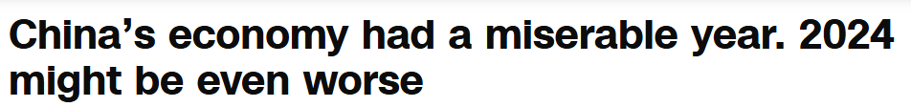

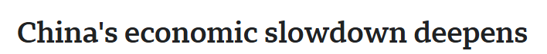

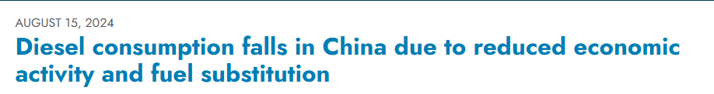

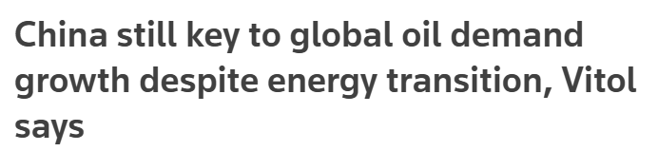

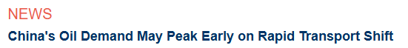

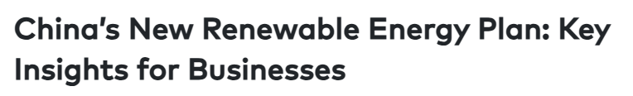

Conversations about China’s economic and industrial slowdown, reduced demand, and challenges began to intensify around August 2023
China’s Economic Outlook
Key Takeaways
China's economic growth is declining primarily due to:
Aging population, weak productivity growth, and limitations of a debt-fueled investment model are leading to insufficient domestic demand and potential stagnation.
Persistent property sector issues and declining foreign investment due to geopolitical tensions.
China's Industrial Slowdowns because of:
Declining private investment, prolonged real estate downturn and weak consumer spending, contributing to slower industrial output and diminished business confidence
Reasons for Reduced Energy Demand in China:
Deceleration in economic activity, particularly in construction and manufacturing sectors, has led to reduced energy consumption.
Ongoing transition to cleaner energy (increased use of LNG-fueled vehicles and EVs) leading to reduced oil consumption.
Implications for the Global Oil and Gas Sector:
China's oil demand, as the world's largest consumer, is expected to peak as early as 2025, potentially reshaping global oil markets and influencing pricing dynamics.
China's energy transition:
China aims for a 30% increase in renewable energy consumption by 2025 and 36% by 2030, focusing on infrastructure upgrades and sector integration.
Energy use is expected to peak by 2030 and decrease by 20% by 2050, driven by electrification (EVs) and energy efficiency, while still relying on fossil fuels.
Timeframe: Jan 01, 2023, to Dec 15, 2024 Source: Desk Research – Media Coverage

Slide 12
Aramco’s Focus in China
Background and deep dive into the company’s contribution to China’s energy market, sustainability, development other relevant associations

Slide 13
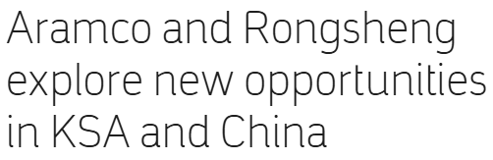

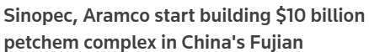
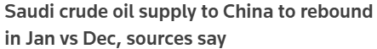
Aramco has played a central role in powering China’s development through energy partnerships, aligning with China’s transition goals
Background - Aramco’s Focus in China
Aramco’s investment commitments and strategic focus in China:
Aramco’s investments align with China’s energy transition goals, balancing traditional energy sources with the growing demand for cleaner energy.
Rongsheng Petrochemical Co. Ltd: In July 2023, Aramco acquired a 10% stake in Rongsheng for approximately $3.6 billion, enhancing its presence in China's petrochemical sector.
Fujian Petrochemical Industrial Park: In November 2024, Aramco, in collaboration with Sinopec, commenced construction of a $9.82 billion refinery and petrochemical complex in Fujian province. The facility is projected to process 320,000 barrels of crude oil per day upon completion by 2030.
Supply Agreements: Aramco's crude oil supply to China is set to rebound to a three-month high in January 2025, reflecting its strategic focus on meeting China's energy demands.
Timeframe: Jan 01, 2023, to Dec 15, 2024 Source: Desk Research – Media Coverage

Slide 14
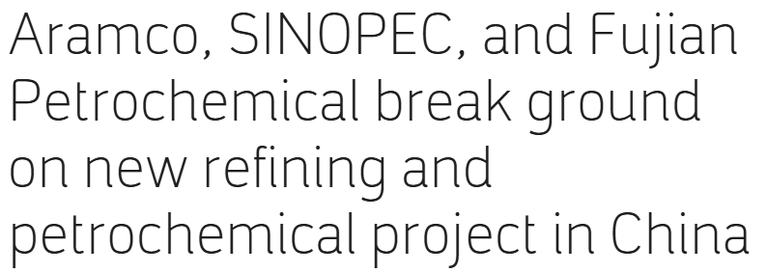

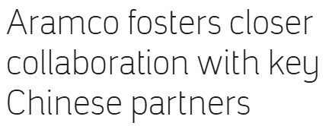
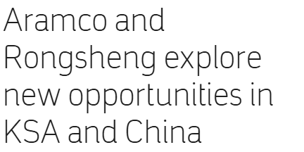
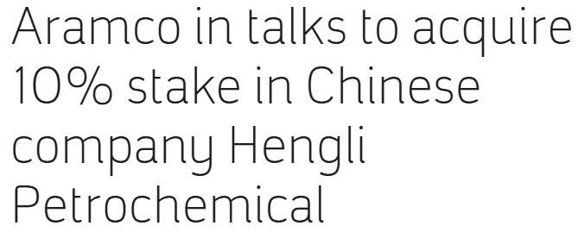
Aramco is strengthening strategic partnerships in China, focusing on petrochemicals, sustainability, and long-term economic investments
Aramco’s Key Media Coverage in China
Strategic Partnerships and Expansion of Downstream Operations: Aramco is forming alliances with key Chinese corporations, particularly in the petrochemical and construction sectors, to enhance mutual growth and sustainability efforts.
Commitment to Sustainability: Initiatives highlight a focus on green technology and sustainable development, aligning with global environmental goals.
Investment in China's Economy: Through investments and joint ventures, Aramco is demonstrating a long-term commitment to China's economic development.
Aramco, in collaboration with SINOPEC and Fujian Petrochemical, initiated the construction of a refining and petrochemical complex, emphasizing its commitment to strategic growth in China’s downstream sector.
Aramco is expanding into sustainable construction and materials, aligning with China's focus on green development. The collaboration aims to innovate and optimize resource utilization.
Aramco and Zhejiang Rongsheng Holding Group signed a cooperation agreement to explore new opportunities in Saudi Arabia and China, expanding Aramco's petrochemical presence
Aramco fostered closer relationships with major Chinese partners to bolster long-term supply agreements and shared technological advancements.
Aramco was negotiating to acquire a significant stake in a Chinese petrochemical company, reflecting its ambition to deepen market presence and integration.
Timeframe: Jan 01, 2023, to Dec 15, 2024 Source: Desk Research – Aramco Press Releases

Slide 15
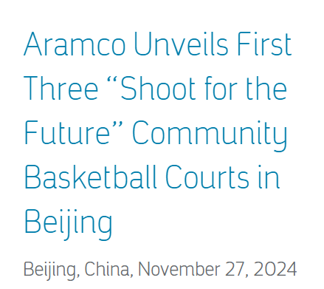
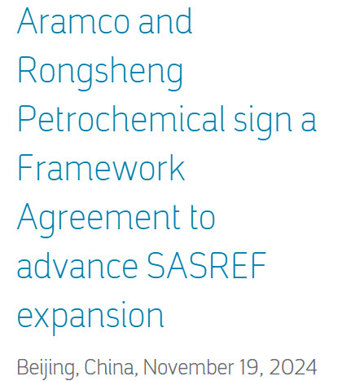
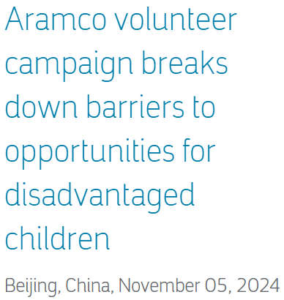
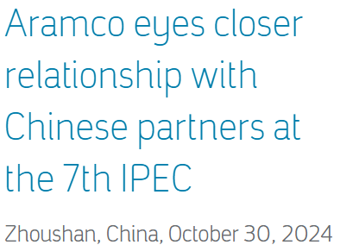
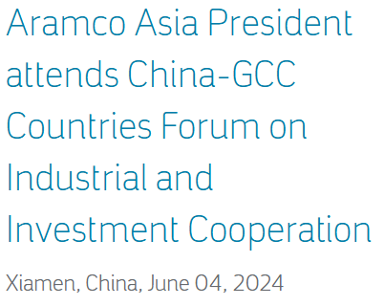

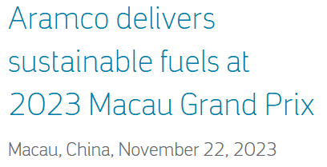
In China, Aramco focused on sustainability, energy investments, community support, cultural initiatives, and trade, while advancing environmental goals and innovation
Key Highlights of Aramco’s Initiatives in China
Sustainability and Community Engagement
Renovated basketball courts in Beijing under the "Shoot for the Future" project, using recycled materials.
Continued the "Children Benefit Program," benefiting underprivileged children with medical aid.
Donated $3 million to the Chinese Red Cross for typhoon relief efforts in Beijing and Fujian.
Energy and Industrial Investments
Expanded refining and petrochemical projects with Rongsheng and Fujian Petrochemical, securing over 1 million barrels/day crude supply agreements.
Delivered offshore platforms for the Marjan field, enhancing oil and gas production.
Invested in major projects, including a $12 billion partnership in Liaoning and a $6.4 billion venture in Fujian.
Cultural, Educational, and Sports Initiatives
Participated in cultural events like the Beijing International Book Fair and sponsored Formula 1 and the Chinese Basketball Association (CBA) League.
Collaborated with Nankai University and SAP to promote green innovation and digital transformation.
Trade and Environmental Focus
Engaged in forums like the China Development Forum and Supplier Summit to strengthen trade ties under the Belt and Road Initiative.
Advanced sustainable fuels for automotive racing and promoted carbon neutrality goals.
Timeframe: Jan 01, 2023, to Dec 15, 2024 Source: Desk Research – Aramco Press Releases

Slide 16
Analysis of Aramco in China
Analysis of Aramco’s relevance in the China Market leveraging Social Media Analytics tool, with a focus on online news sources

Slide 17
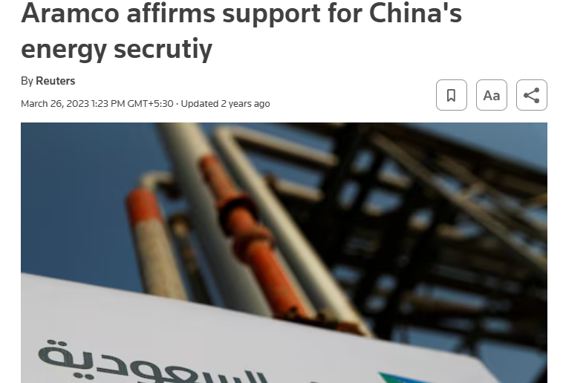
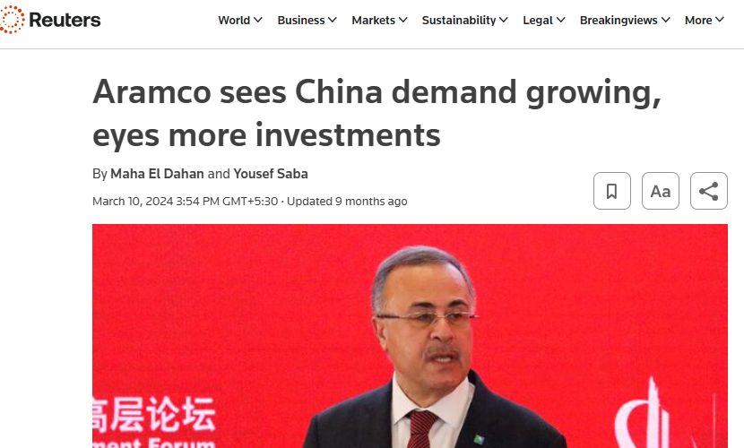
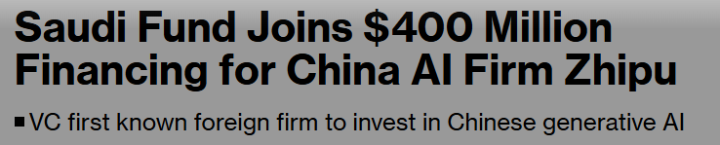
Aramco was primarily in discussion around China for its strategic partnerships, investments, and oil and Gas pricing and demand in the country
Aramco’s Conversation Analysis
Online News Sources – Sentiment Overview
Conversation Trendline
Aramco affirmed support to China with partnerships and emission-reducing technologies to make lower carbon products.
Saudi Aramco looking at further opportunities to invest in China
Saudi Aramco’s Prosperity7 Ventures, LLC became the first known foreign firm to invest in Chinese generative AI startup, Zhipu
210,599 Mentions
163,749 Mentions
46,850 Mentions
Timeframe: Jan 01, 2023, to Dec 15, 2024 Source: Brandwatch (Online news, social media platforms such as x, blogs & Forums Language Focus: English, Chinese & Arabic

Slide 18
Online news channels dominated the engagement with 78% mentions around Aramco with reference to China, with other sources also talking about the sports appeal
Summary: Aramco’s Conversation Themes
Online News
Other Online Sources
Other online sources (social media platforms such as X, blogs, forums, etc.) indicated a comparatively lower engagement with 46,850 mentions around Aramco in relation to China.
35% of the conversations were around the refining and petrochemical complex, and CEO Amir Nasser’s thoughts shared during summits such as the ‘Invest in China’.
12% conversations aligned with the oil price and demand related mentions in online news channels.
2% talked about Aramco’s Formula 1 sponsorship reflecting the sports appeal and investment in China.
There have been 163,749 mentions of Aramco in online news in reference to China over the last two years.
60% of the conversations highlighted Saudi Aramco’s extensive strategic collaborations with Chinese conglomerates to enable growth and development.
40% conversations discussed China’s energy demand and its influence on global oil prices, highlighting the challenges of potential supply shortage and tight oil markets.
Timeframe: Jan 01, 2023, to Dec 15, 2024 Source: Brandwatch (Online news, social media platforms such as x, blogs & Forums Language Focus: English, Chinese & Arabic

Slide 19

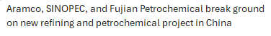







Aramco’s strategic partnerships and investments in China, rising inflation threat and its impact on the oil prices and demand dominated the news conversations for Aramco China
Aramco’s Conversation Themes – Online News
Expansion and Strategic Investments
(98,484 Mentions)
42%
Oil Price and Demand
(69,138 Mentions)
60%
Saudi Aramco strengthened its ties with China through strategic investments and partnerships including:
A 10% stake in Rongsheng Petrochemical
Collaboration with Huajin Aramco Petrochemical on a refinery project in Liaoning
A $9.82 billion complex with Sinopec in Fujian
a 10% stake in Horse Powertrain Limited, and joint projects with Shandong Energy Group in Shandong Province
China's growing energy and petrochemical demand along with its economic recovery, influences global oil prices.
As Aramco strengthens its role as a key supplier, its strategic investments and partnerships aim to stabilize supply and cater to China’s needs, potentially impacting oil price dynamics.
Base Volume: 163,749 Mentions
Timeframe: Jan 01, 2023, to Dec 15, 2024 Source: Brandwatch (Online news, social media platforms such as x, blogs & Forums Language Focus: English, Chinese & Arabic

Slide 20
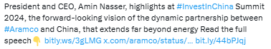
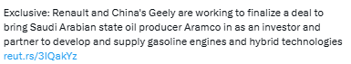
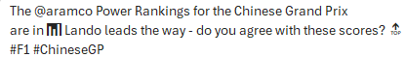
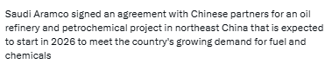
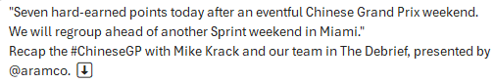
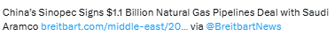
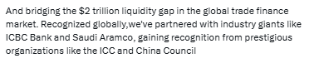
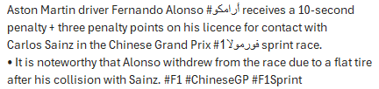

Aramco was in discussion for expanding its footprint in China with major investments and partnerships, focusing on oil demand, supply challenges, and increasing influence in sports like Formula 1
Aramco’s Conversation Themes – Other Social Channels
Partnership with China
(16,401 Mentions)
Oil Price and Demand
(5,921 Mentions)
Sports initiatives and sponsorships (913 Mentions)
35%
13%
2%
Saudi Aramco has signed multi-billion dollar agreements to build a refining and petrochemical complex in China and also acquiring a 10% stake of Rongsheng Petrochemical in $3.6 billion deal, strengthening its presence to meet growing demand.
CEO Amin Nasser highlighted Aramco's broad partnership with China at the ‘Invest In China’ Summit and China Development Forum 2024.
Conversations highlighted that Saudi Aramco was optimistic about China's robust oil demand, driven by economic growth and rising energy needs.
However, there were warnings of potential supply shortages and price fluctuations amid surging demand and tight global oil markets.
Aramco's involvement in Formula 1, through strategic partnerships and sponsorships, highlighted the sport's growing influence in China, where expanding events and global popularity continue to captivate a massive audience.
Base Volume: 46,850
Timeframe: Jan 01, 2023, to Dec 15, 2024 Source: Brandwatch (Online news, social media platforms such as x, blogs & Forums Language Focus: English, Chinese & Arabic

Slide 21
Challenges and Points of Misalignment
Assessment of the potential challenges, the current points of misalignment and recommendations for Aramco based on the analysis

Slide 22
Aramco can support China’s short-term energy needs while adapting to its green energy goals and navigating economic and geopolitical challenges
Challenges and Points of Misalignment for Aramco
Potential Challenges for Aramco:
Current Misalignments for Aramco:
Uncertain impact of Trump administrations and US policies on China’s energy industry.
A potential delay in existing project timelines, such as the Fujian Petrochemical Industrial Park, due to regulatory hurdles or financial risks from lower-than-expected demand.
Any further trade tensions in China could impact investment flows and operational stability in the country, further impacting the economic growth.
As Aramco moves forward in alignment with the country’s policy shifts and clean energy focus, limited investments in high-growth sectors like renewable energy or digital technology could restrict long-term growth potential in China.
While Aramco is building sustainability partnerships in China, its main investments remain focused on petrochemicals and traditional energy, which may conflict with China’s goal of shifting towards clean energy.
The petroleum requirements of the country have been volatile. Even though petroleum consumption is expected to rise as early as 2025, fluctuations are not certain due to economic uncertainty and policy interventions.
Recommendations for Aramco:
Strengthen the investments in renewable energy and technology sectors to align with China’s clean energy push and lessen risks from geopolitical or economic downturns (E.g. change in US government policies and decline in GDP, respectively)
Foster collaborations in the country to drive innovation in the energy sector that can attract international interest and investments.

Slide 23
Thank You

